Slide 1



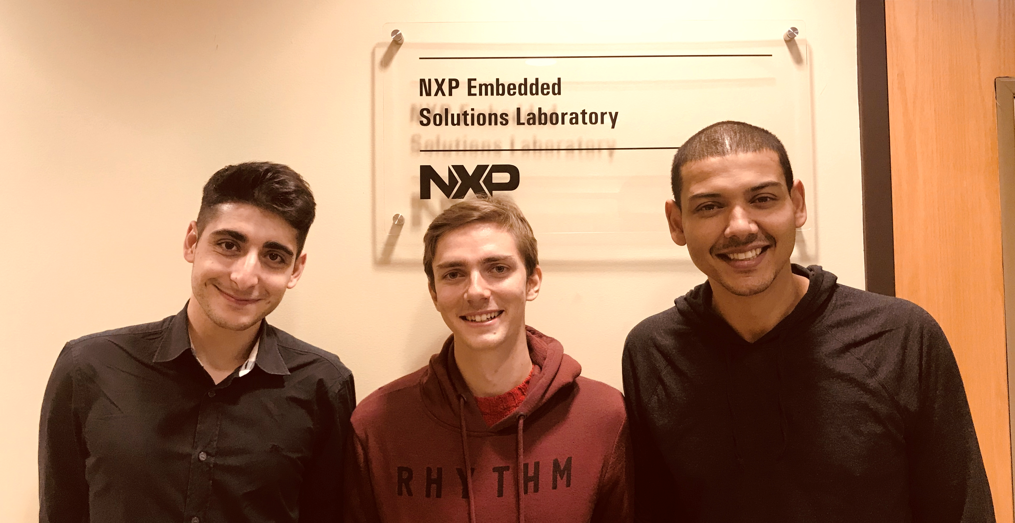
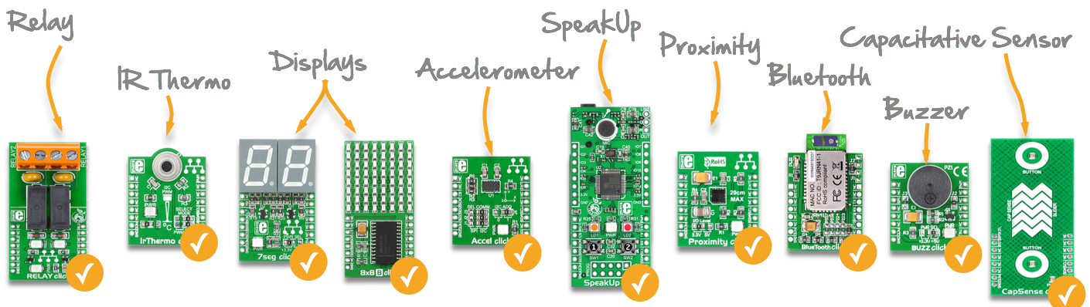
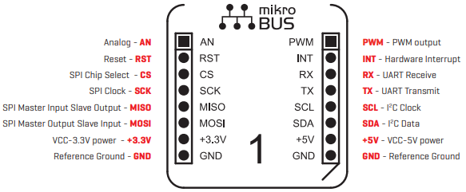
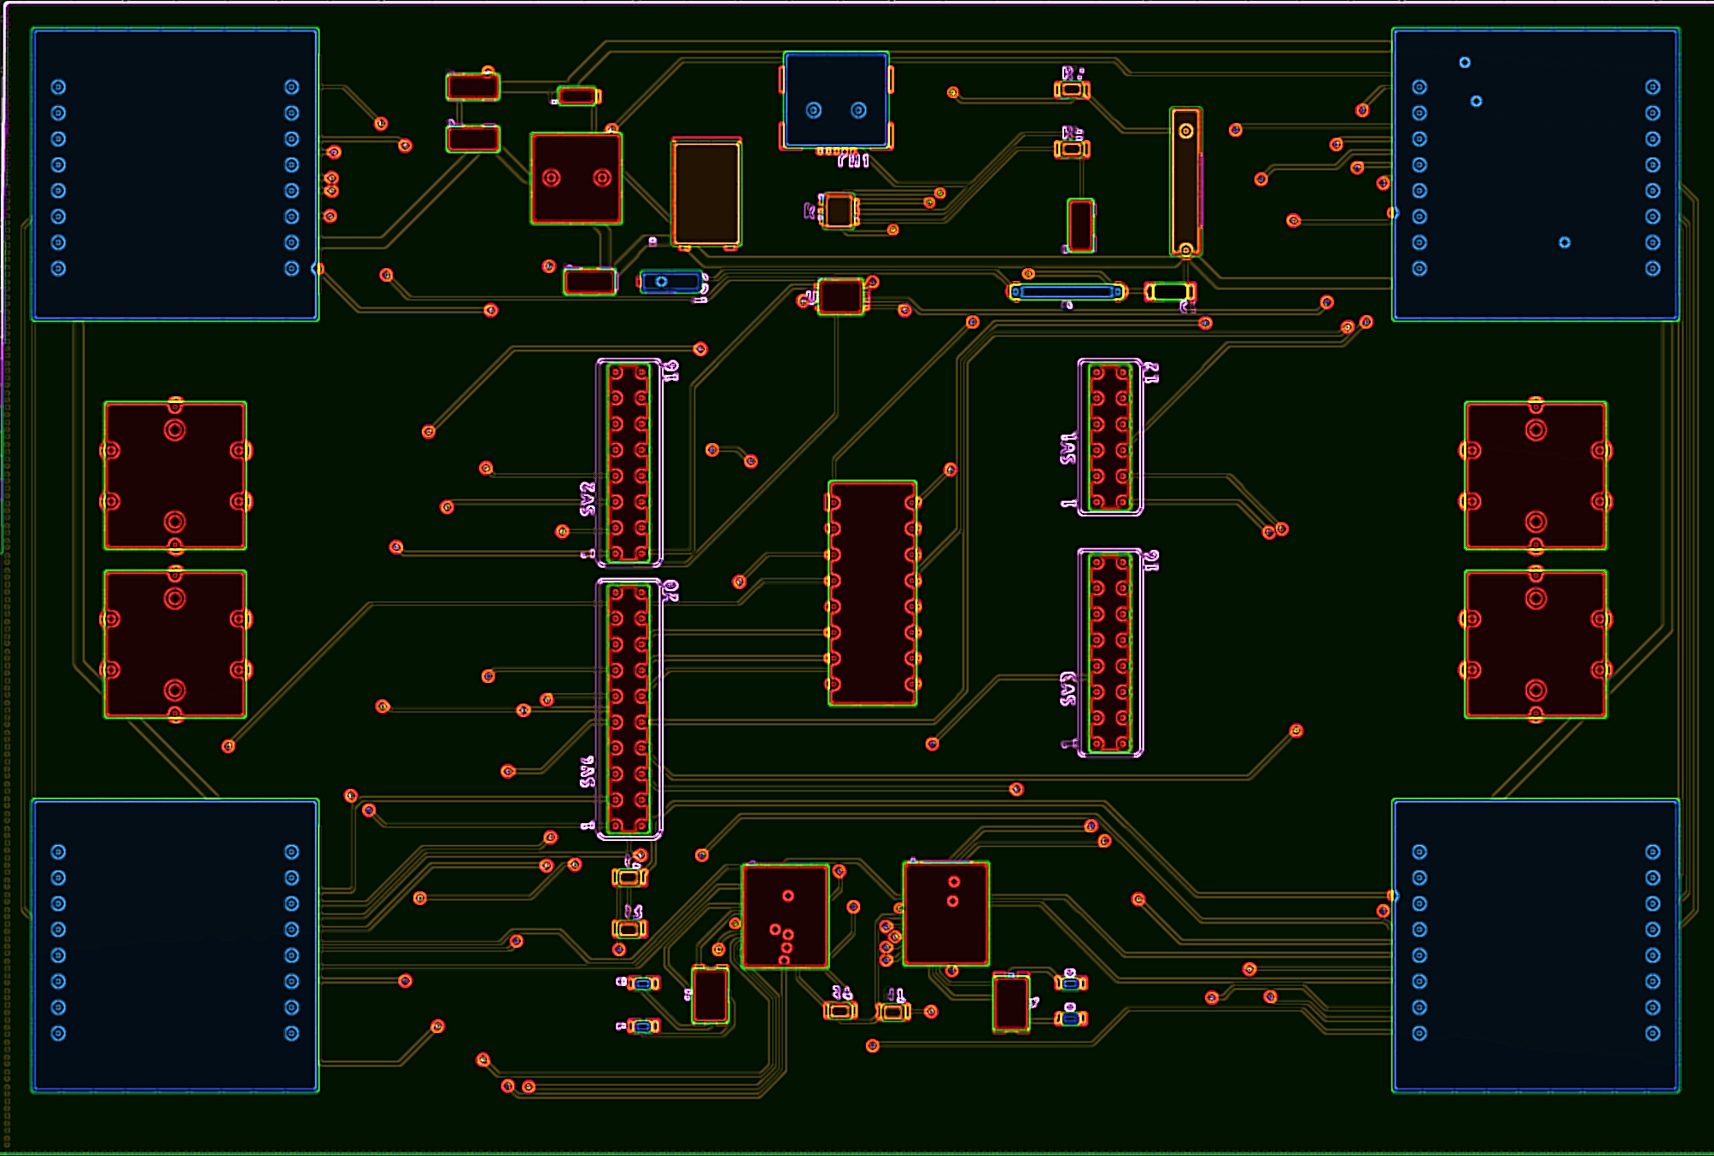


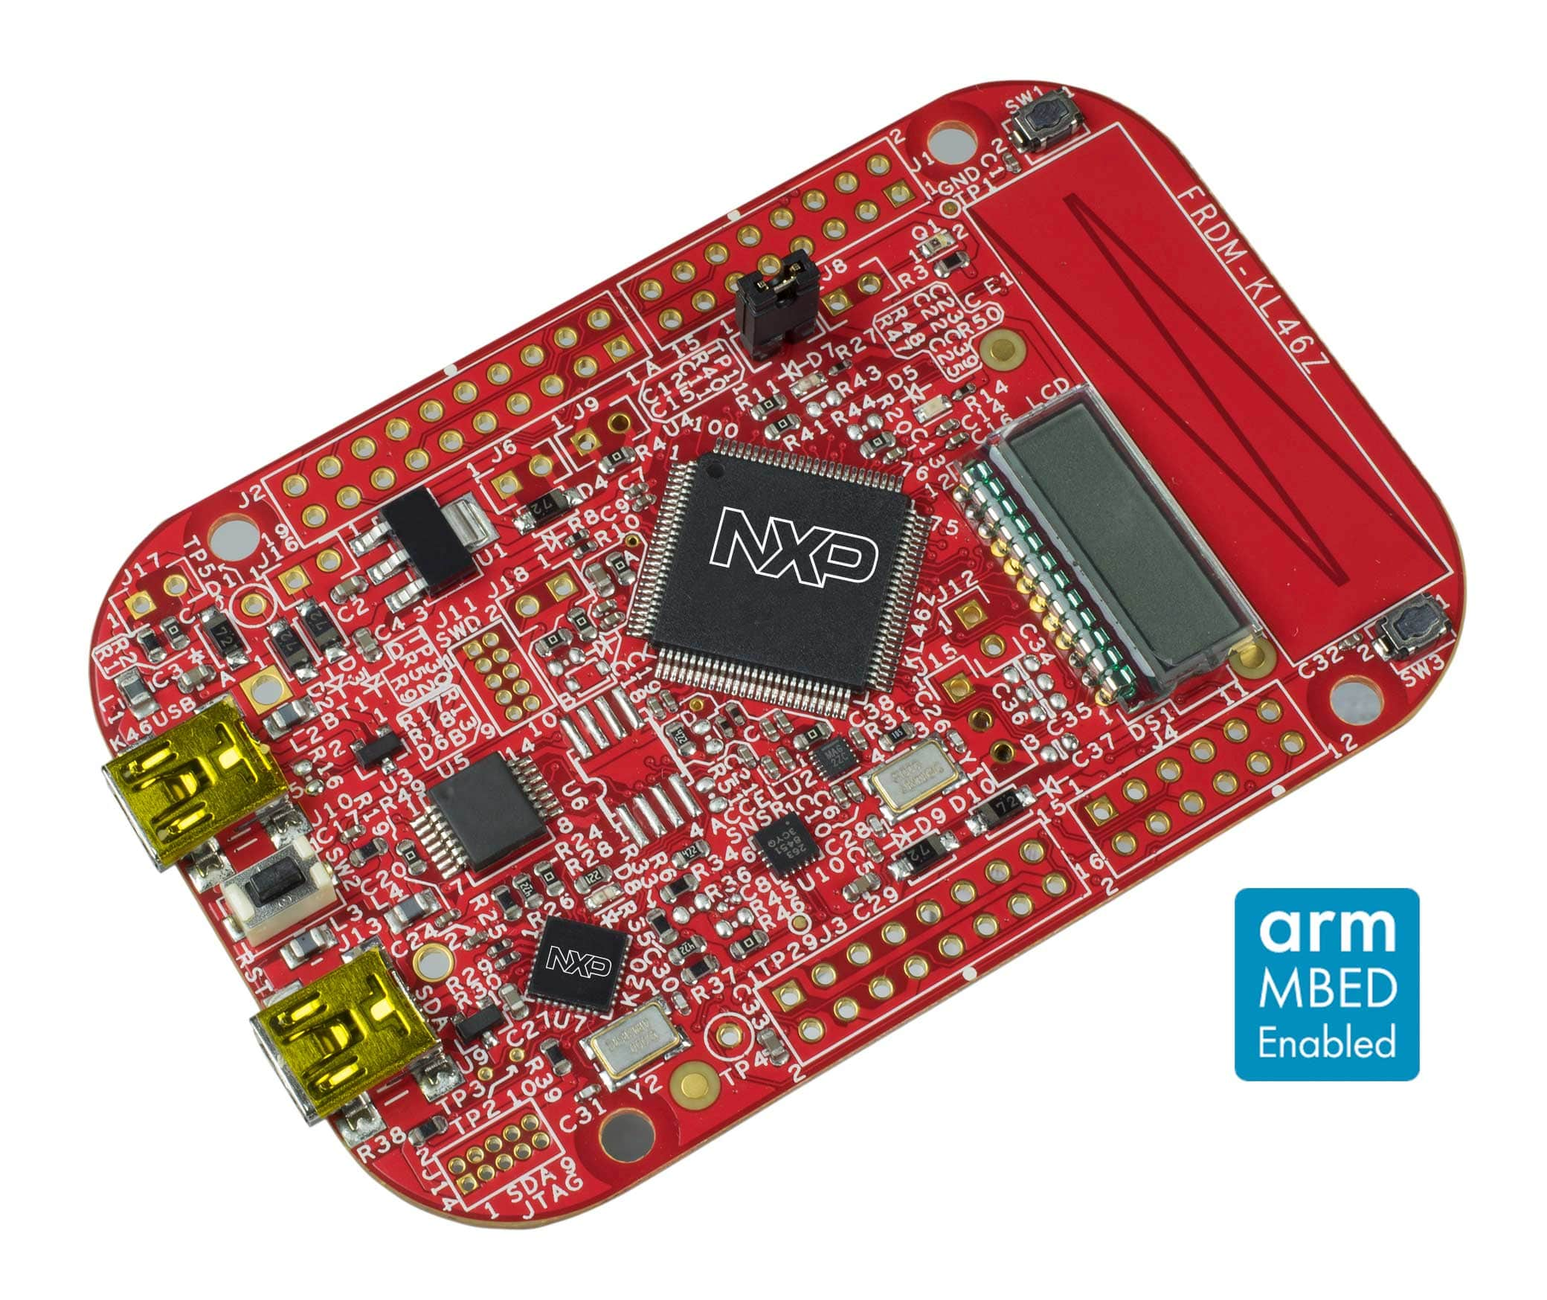
E1.8 CLICK SENSOR HUB
Alfonso De La Morena, Mohamed Sghari, Dylan Dean Ingram School of Engineering , Texas State University
SHIELD 46
TEAM MEMEBERS
(Dylan, Alfonso, Mohamed)
ACKNOWLEDGMENTS
Special Thanks to
Dr. Bill Stapleton (Left)
Dr. Kevin Kemp (Right)
Advisor Sponsor
Project Overview
​Project Description:
Click Sensor Hub is an IoT extension for the FRDM-KL46Z development platform.
Project Motivation:
Enables a lost cost NXP development board to evolve into a modern IoT project kit.
The four mikroBUS™ socket design goes beyond the current two socket capabilities of NXP clickSHIELD
Project Design Flow:
Hardware Design
PCB Connectivity with KL46Z
PCB Connectivity with Click
Software Design
Code for ten select Clicks.
Any of the four mikroBUS™ sockets have connectivity with ten selected Click.
Store and format Data Values.
Simple Data Analytics
Access the data and perform basic calculations. (High/Low Value, Mean,…)
Next Semester Deliverables:
Completed PCB Design
Functionality Code for Ten add-on boards
Error Handling/User Guide Created
Demo Video of Rapid IoT Functionality
(Stretch Goal) Website for Data Analytics
EXPANDED DESIGN BREAKDOWN
Click and Go Design: Take any Click connect it to any mikroBUS™ socket begin your IoT project
What is the mikroBUS™ Standard and How its changed IoT
9-12 DC Connector
mikroBUS™ Socket [1of4]
mikroBUS™ Socket [2of4]
Voltage Regulator 3.3V
Voltage Regulator 5.5V
IC Decoder
Reset 1
Reset 2
IC Encoder
Reset 4
FRDM-KL46Z Top Mounted with Through Headers
Reset 3
mikroBUS™ Socket [4of4]
Two IC
SPI to Dual UART
mikroBUS™ Socket [3of4]
12Mhz Crystal Oscillator

